Slide 1
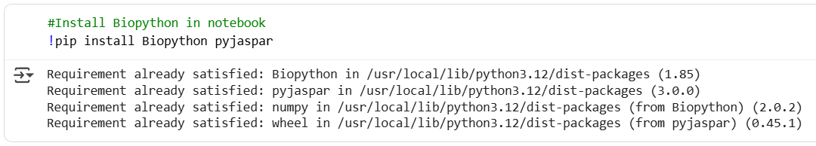
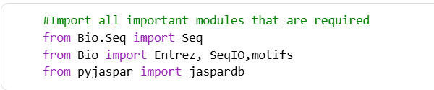
Installing Biopyhton and Pyjaspar ✨ Biopython → A powerful Python toolkit that helps biologists analyze DNA, RNA, and protein data, and handle common bioinformatics file formats. ✨ PyJASPAR → A Python interface to the JASPAR database that lets you search, retrieve, and work with transcription factor binding motifs programmatically.
Importing the right tools for Sequence analysis.

Slide 2
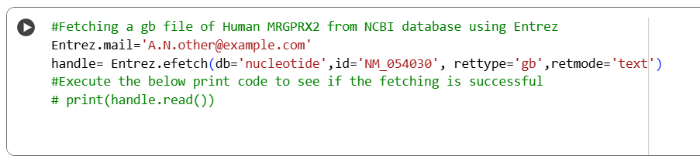
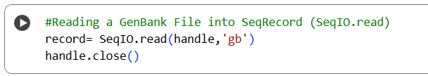
Fetching Genbank file ffrom NCBI using Entrez module
Reading a GenBank File into SeqRecord (SeqIO.read)

Slide 3
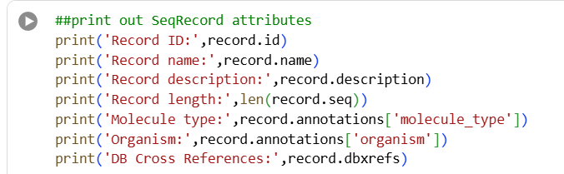
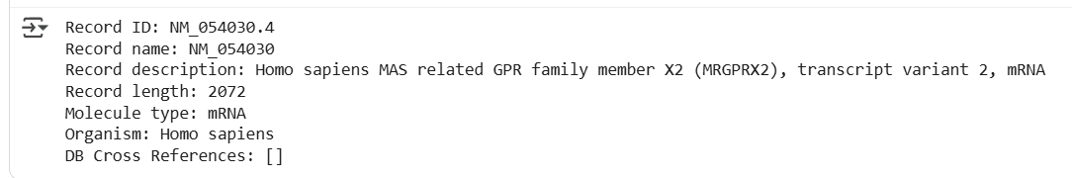
Key Attributes of a SeqRecord Object
SeqRecord attributes are the properties you can access to get all metadata and features linked to the sequence.
A SeqRecord is like a container for one biological sequence, and it has several attributes: .seq, .id, .name, .description etc.
Input
Results

Slide 4
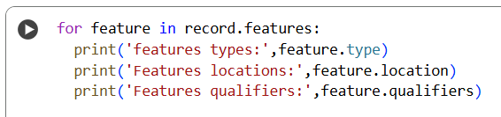
Key Attributes of a SeqFeature Object
SeqFeature objects let you access and work with functional regions of a sequence (like genes and coding regions) instead of just raw nucleotides.
Input
Results
SeqFeature has successfully provided detailed information about feature type, location, and biological annotations within a sequence.

Slide 5
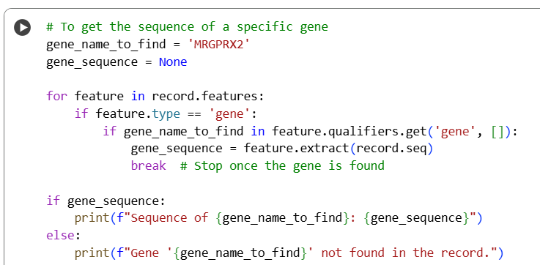
Using SeqFeatures to Isolate a Specific Gene
This makes it easy to fetch the sequence of interest, such as the MRGPRX2 gene.
Input
Results
SeqFeatures has fetched the sequence of a specific gene (e.g., MRGPRX2) from a larger DNA record.

Slide 6
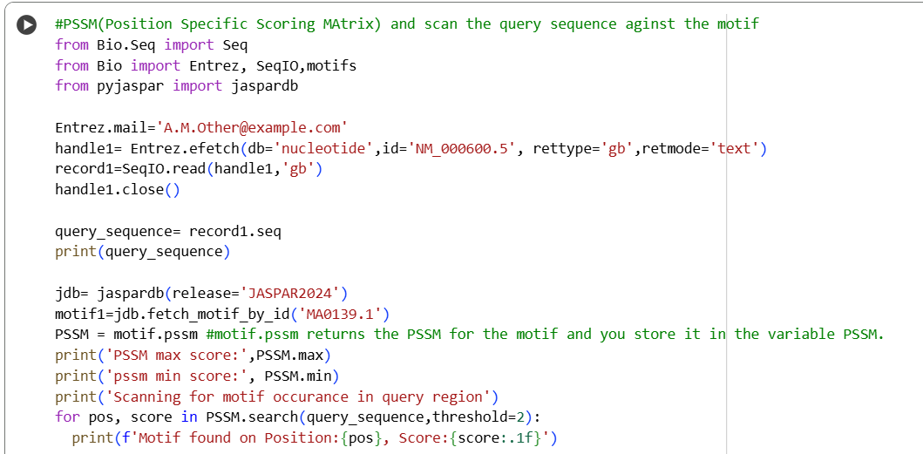
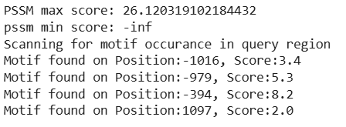
Motif Scanning in Query Sequence using PSSM
Using transcription factor motifs from the JASPAR database, a Position Specific Scoring Matrix (PSSM) is generated.
The PSSM is then applied to the query sequence to identify positions with high scores, indicating potential binding sites.
Input
Results
PSSM scanning detected multiple motif hits across the query sequence, with both positive and negative positions.
The motif at position −394 (score: 8.2) is the strongest candidate, suggesting a higher likelihood of functional binding.

